Slide 1
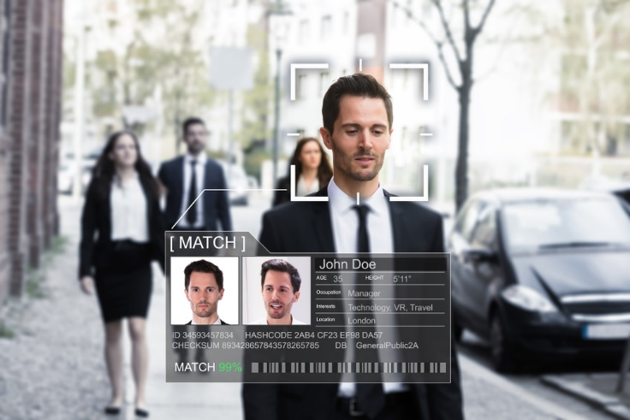
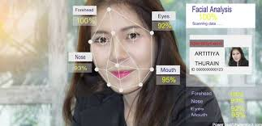
Face recognition using PCA
What is facial recognition?
Facial recognition is a way of identifying or confirming an individual’s identity using their face. Facial recognition systems can be used to identify people in photos, videos, or in real-time.
Facial recognition is a category of biometric security. Other forms of biometric software include voice recognition, fingerprint recognition, and eye retina or iris recognition. The technology is mostly used for security and law enforcement, though there is increasing interest in other areas of use.
NEXT

Slide 2
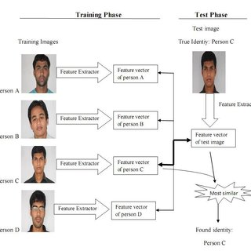
HOW principal component analysis is used in face recognition:
PCA is a statistical approach used for reducing the number of variables in face recognition. In PCA, every image in the training set is represented as a linear combination of weighted eigenvectors called eigenfaces. ... A number of experiments were done to evaluate the performance of the face recognition system.
NEXT

Slide 3
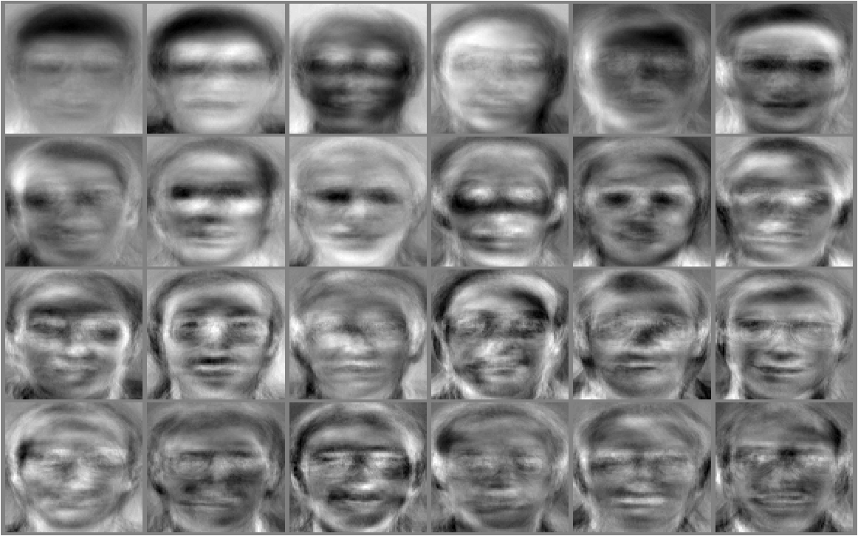
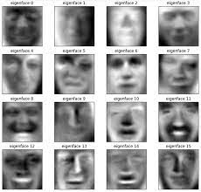
Eigenface Eigenfaces is a method that is useful for face recognition and detection by determining the variance of faces in a collection of face images and use those variances to encode and decode a face in a machine learning way without the full information reducing computation and space complexity.
The strategy of the Eigenfaces method consists of extracting the characteristic features on the face and representing the face in question as a linear combination of the so called 'eigenfaces' obtained from the feature extraction process. The principal components of the faces in the training set are calculated.
Next

Slide 4
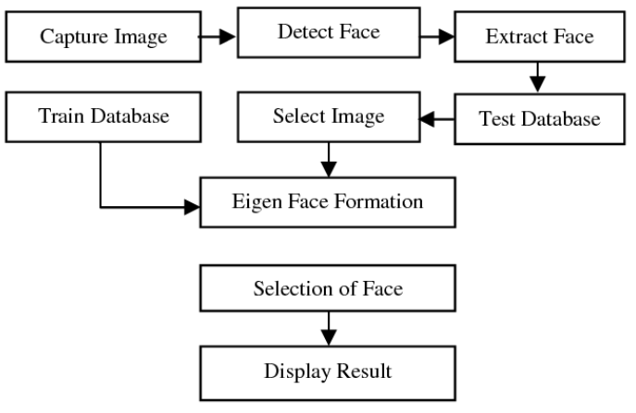
How It Works
Next

Slide 5
Conclusion how face recognition be useful for us
Face recognition can be used to find missing children and victims of human trafficking. As long as missing individuals are added to a database, law enforcement can become alerted as soon as they are recognized by face recognition—be it an airport, retail store or other public space.
End

Slide 6
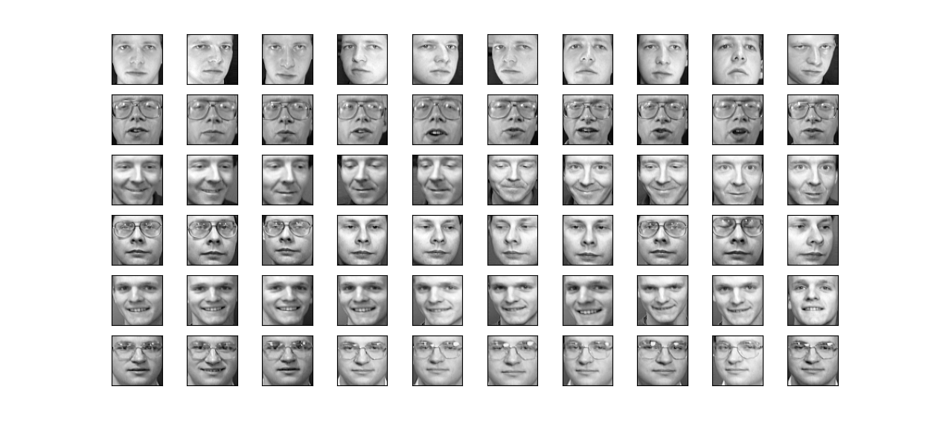
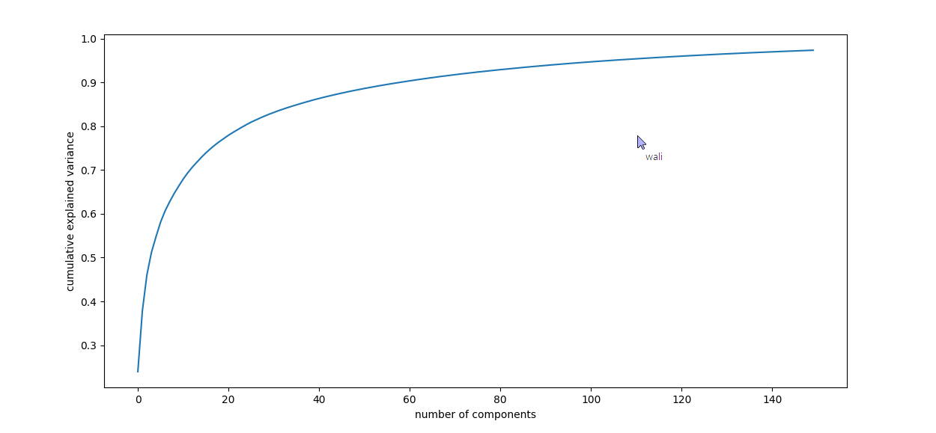
Screenshot of Project

Slide 7
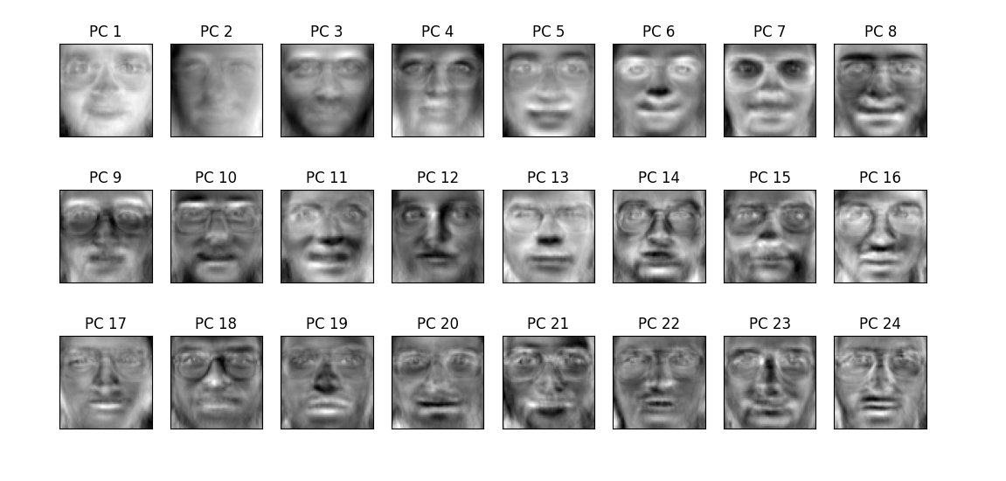
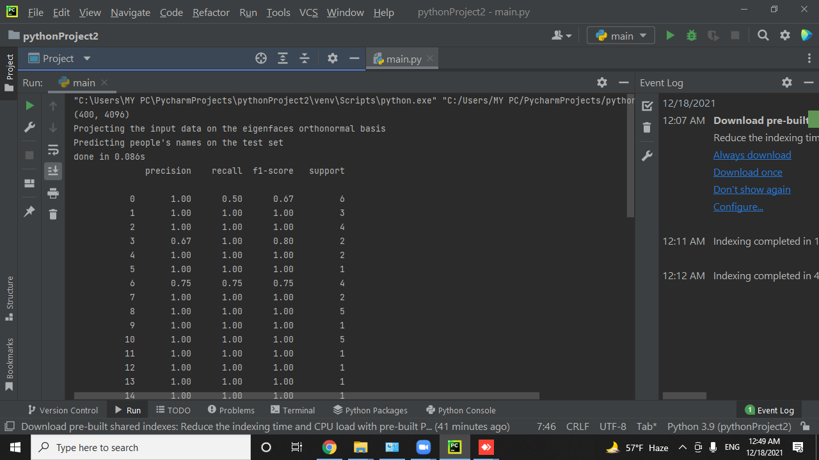
Screenshot of Project

Slide 8

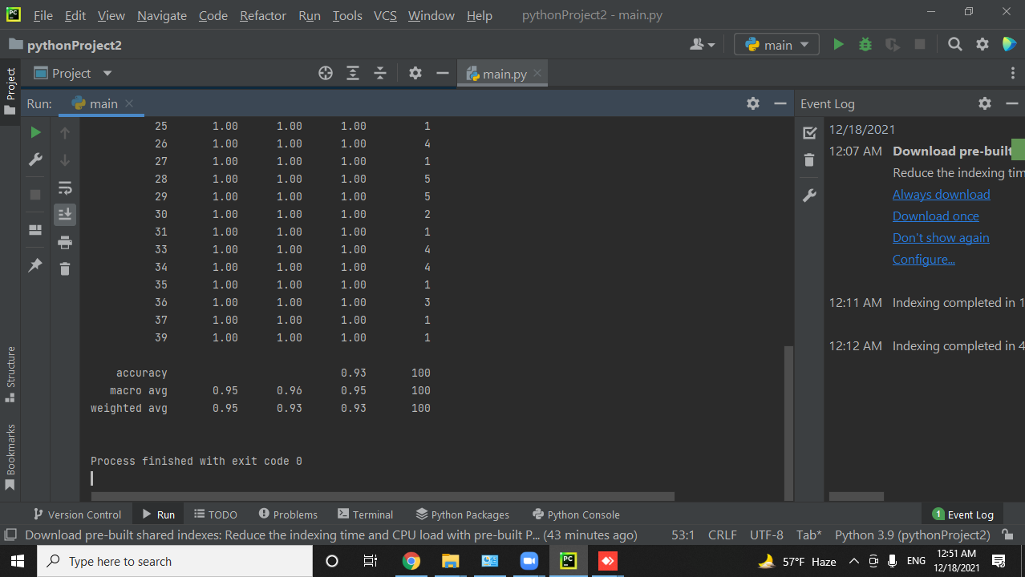
Screenshot of Project

